Slide 1
Decision and CEA
2023年10月03日

Slide 2
Agenda
Quick review of simple Markov model and survival functions
Heemod workshop
Video review and preview
Lecture and discussion

Slide 3
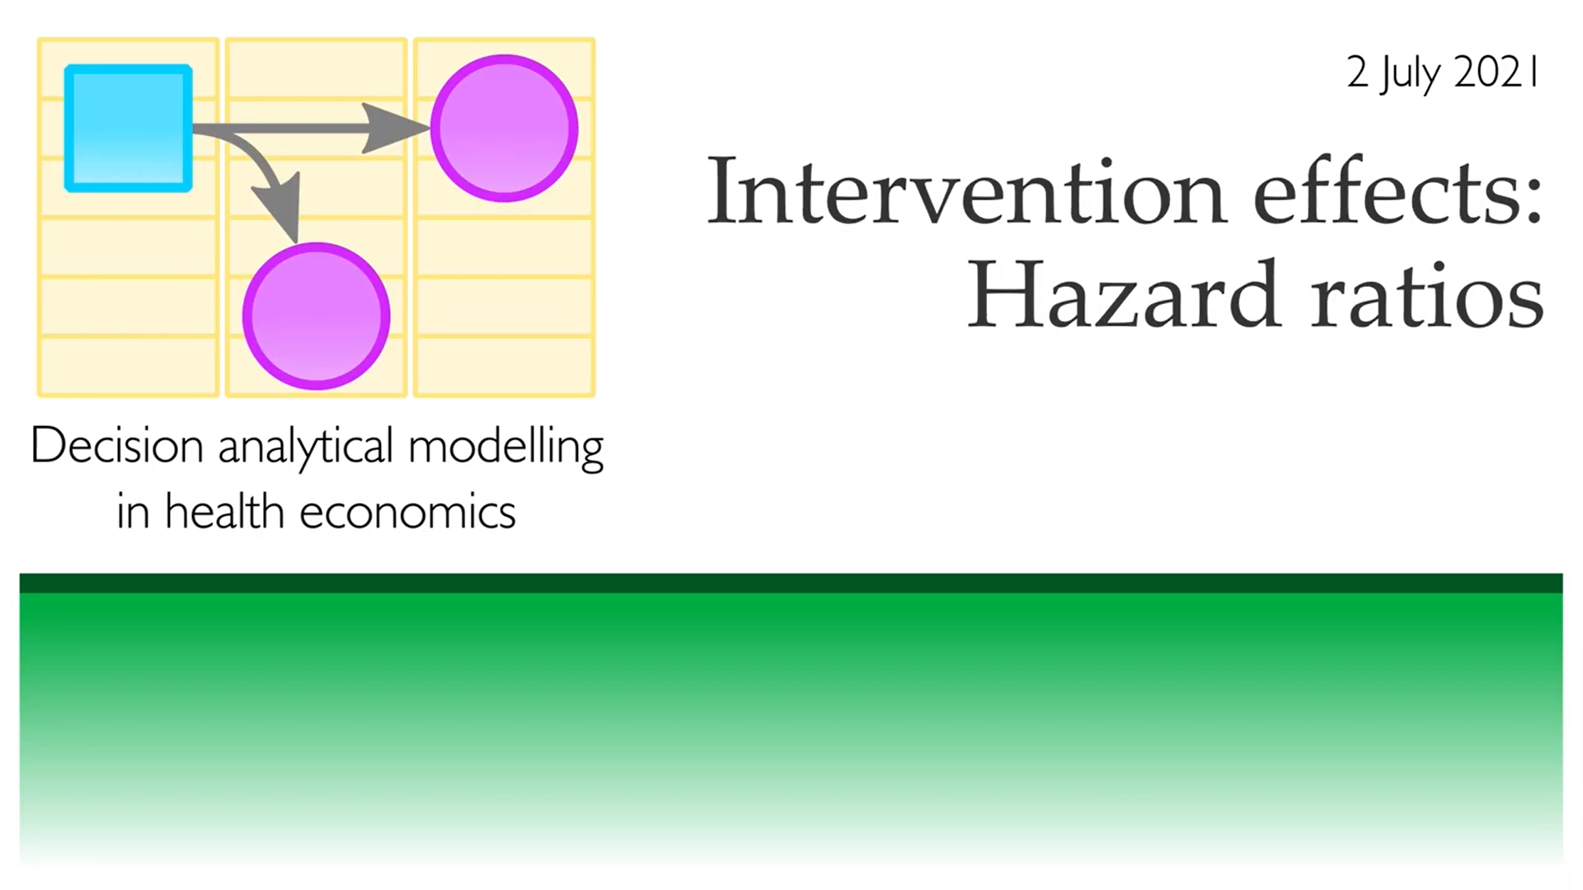
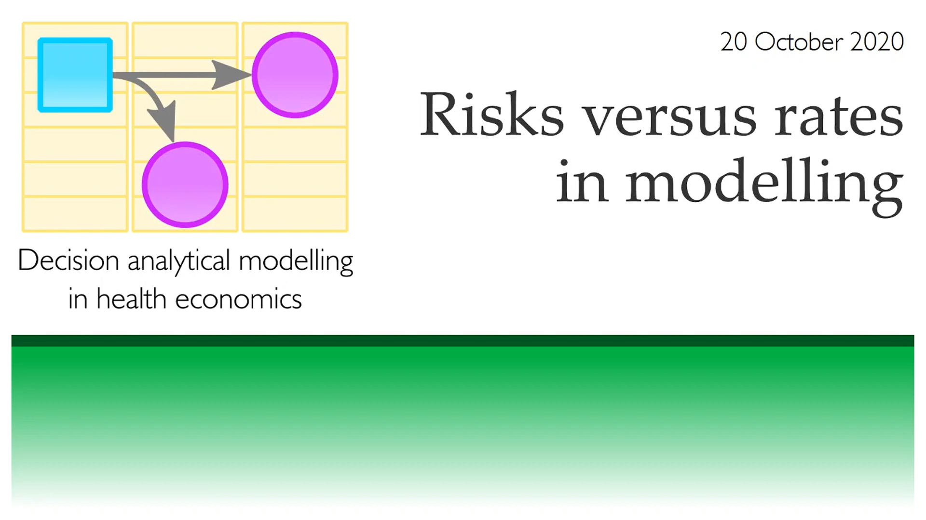


https://www.youtube.com/watch?v=uBQ1Ow-6O2Y
https://www.youtube.com/watch?v=787gUuPUn3Q
https://www.youtube.com/watch?v=ATey9Z4R8oI
https://www.youtube.com/watch?v=U81LW7czsf4

Slide 4
Agenda
Introduction of decision tree and Markov model
Survival Analysis
R/heemod

Slide 5
Part I: Decision tree and introduction of Markov Model

Slide 6
Wrap up:
Specifying the decision problem
structuring the decision model
Output of CEA: ICER, CE plane, NHB, NMB

Slide 7


Slide 8
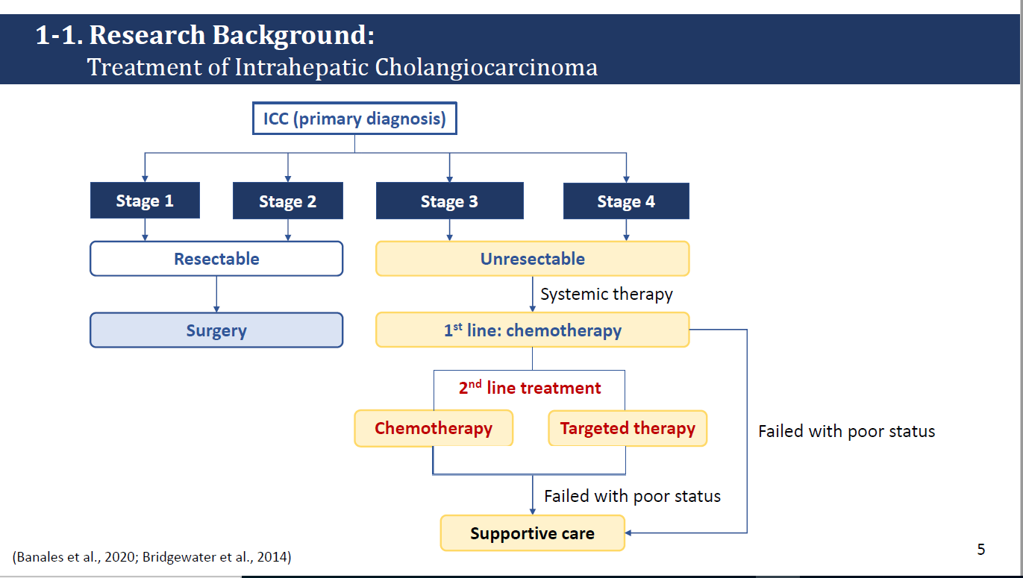

Slide 9


Slide 10
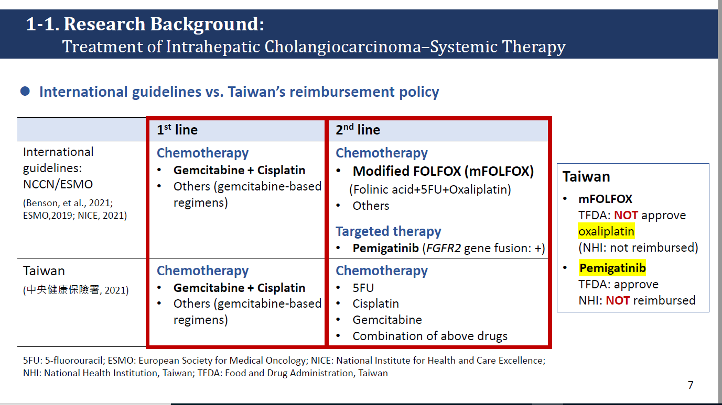

Slide 11
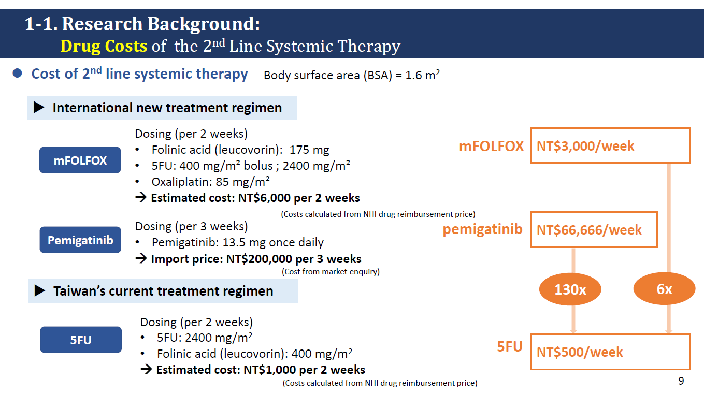

Slide 12


Slide 13
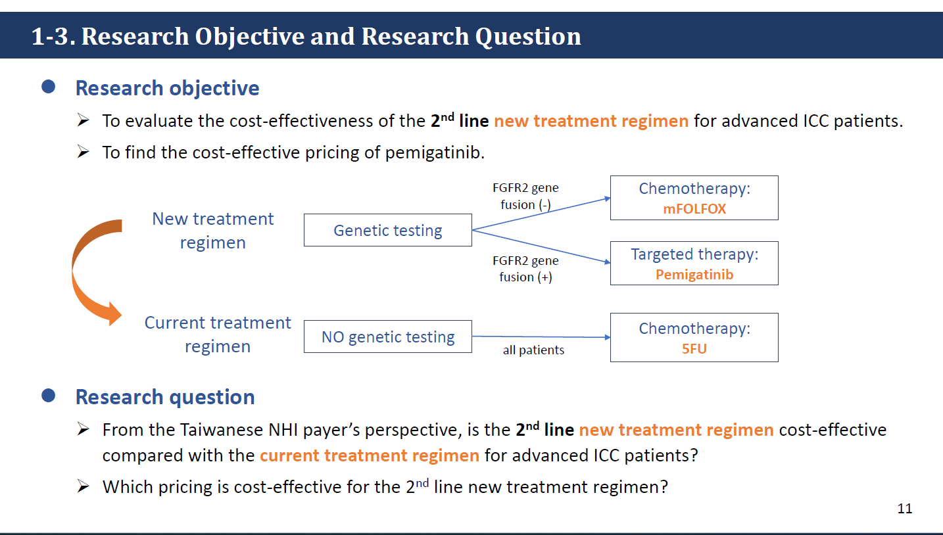

Slide 14
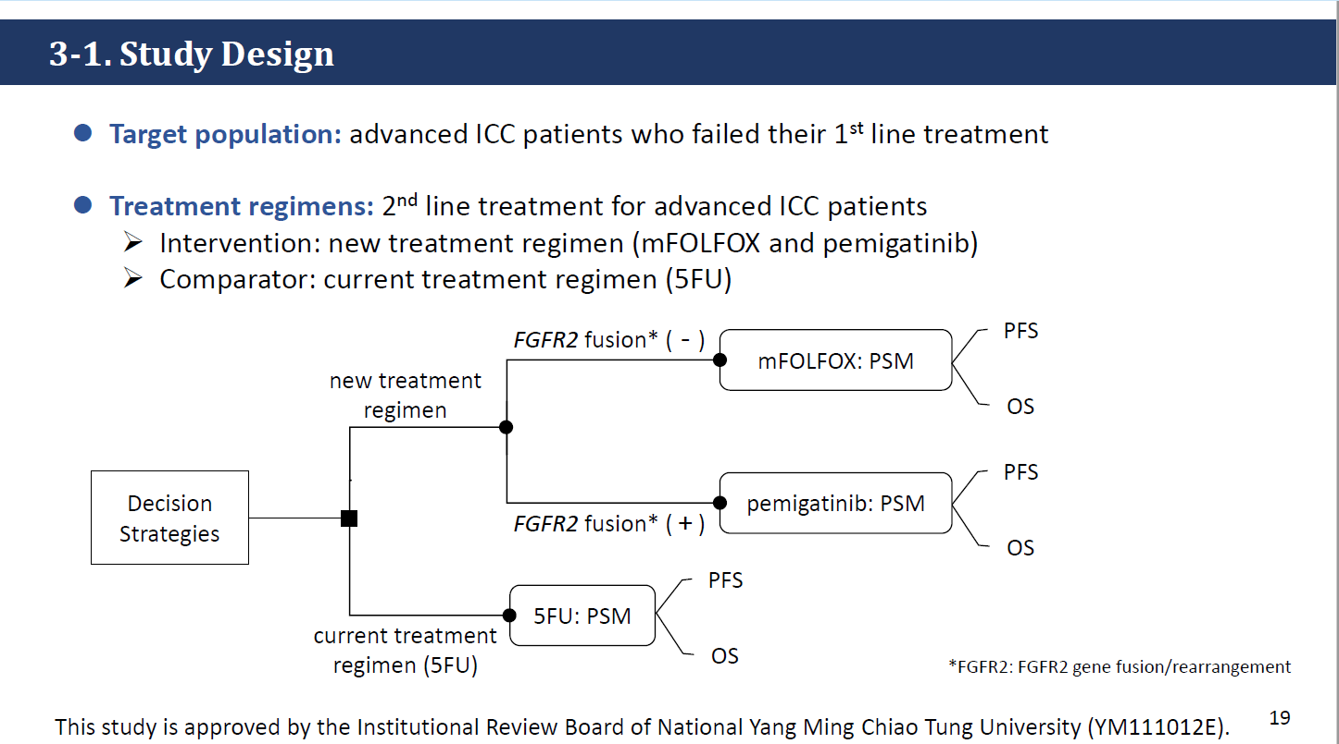

Slide 15
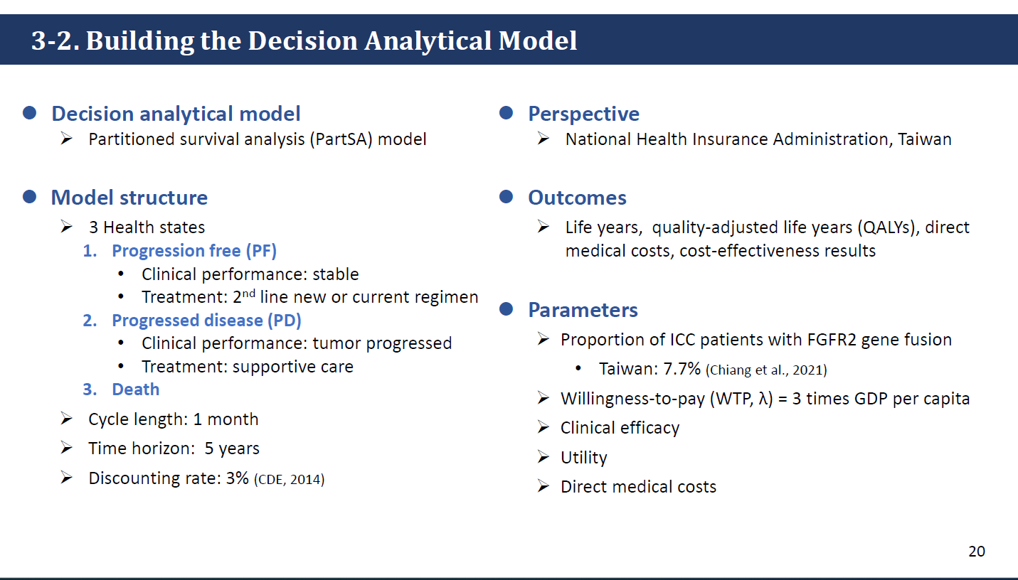

Slide 16
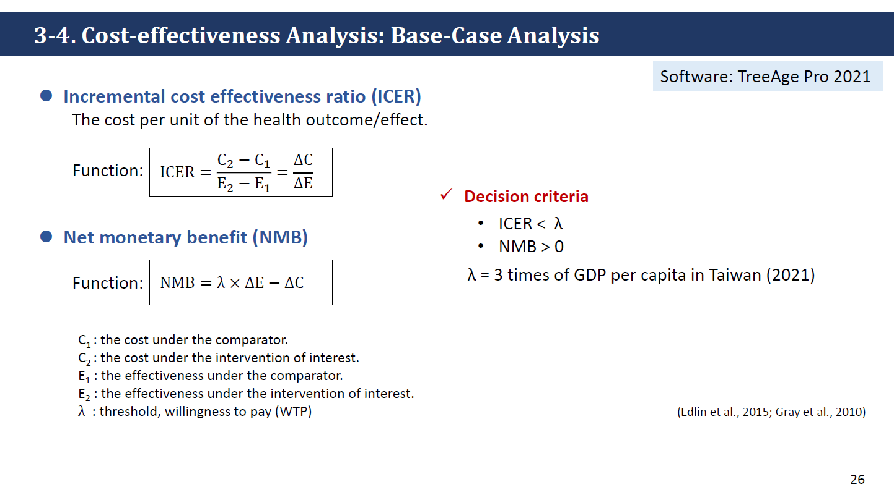

Slide 17
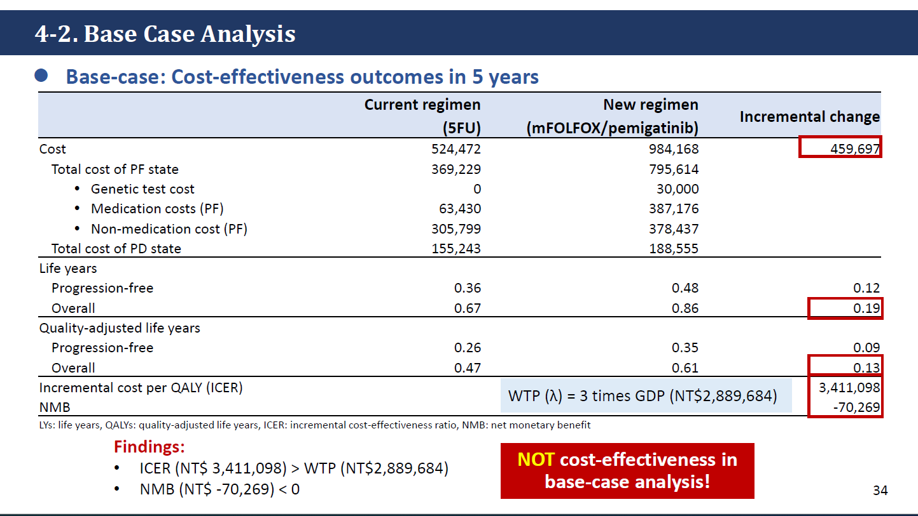

Slide 18
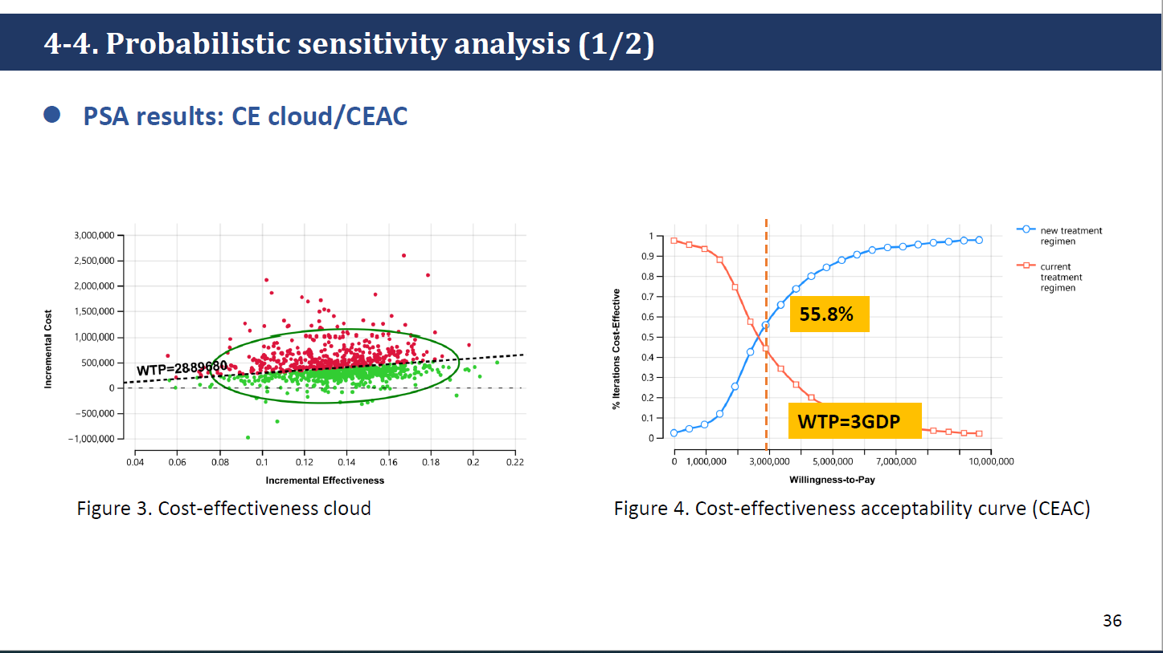

Slide 19


Slide 20
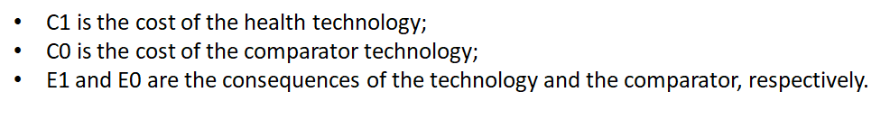
Principle of efficiency: incremental cost over incremental consequence
cost-effectiveness analysis denotes an economic evaluation that measures costs in a monetary unit and quantifies a single consequence in a physical or natural unit (e.g., the number of successfully treated patients, the number of life years gained, the number of symptom days averted).
Notes:
為什麼不用average比較？而用incremental。
經濟學在意的是：marginal benefit為多少。所以使用的是incremental。

Slide 21
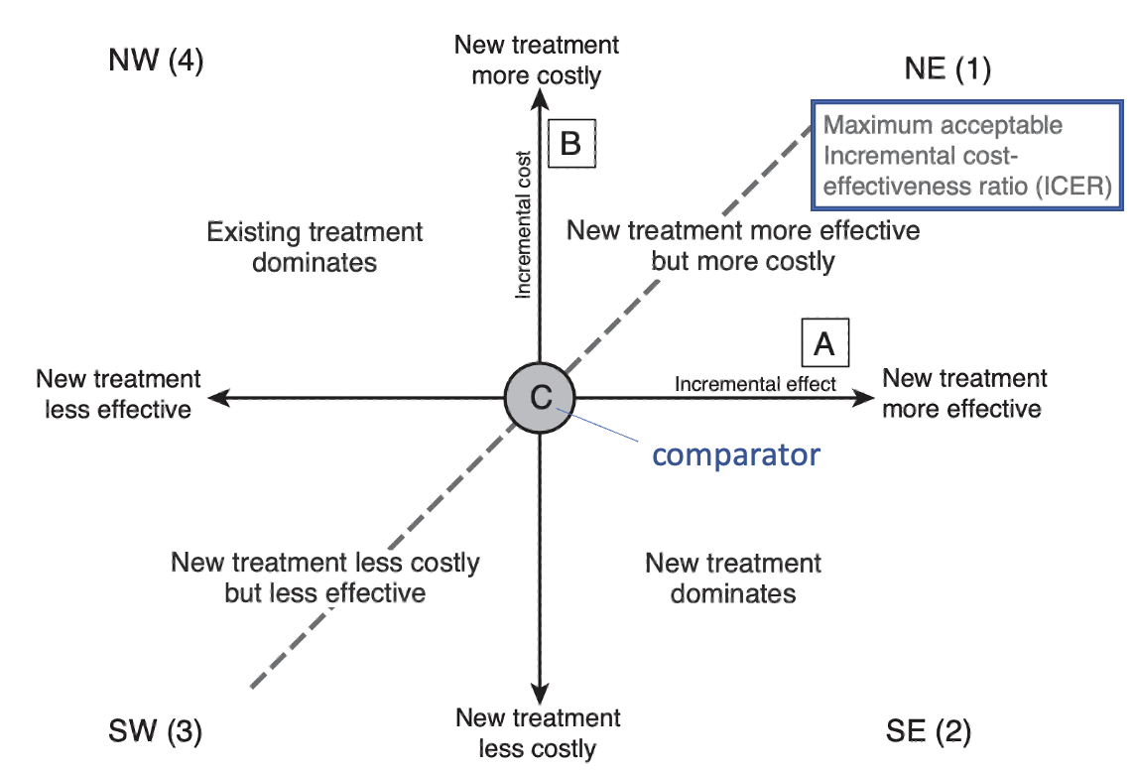
Review of Basics
Cost-effectiveness plane:
Threshold value
(willingness to pay)
How much the decision-maker is willing to pay for health gain
= the maximum value of λ
Notes:
ICER越大：代表？
ICER缺點就是一三象限都很難

Slide 22
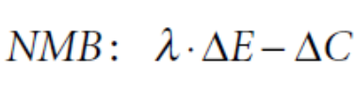
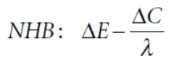
Net health benefit/Net monetary benefit
Net monetary benefit (NMB) is a summary statistic that represents the value of an intervention in monetary terms when a willingness to pay threshold for a unit of benefit (for example a measure of health outcome or QALY) is known.
Net health benefit (NHB) is a summary statistic that represents the impact on population health of introducing a new intervention
Notes:
這個源自public policy
Williness to pay代表願意付出的價值
因為lamda = delta C/ delta E
Effiency 在講政策的時候，
NHB只是decision making的一個部分，還有很多平等equality

Slide 23
Method
Trial-based vs. Analytical decision modeling

Slide 24
When to use
BMJ 2011;342:d1766
Randomised trials do not always provide a sufficient basis for economic evaluations used to inform regulatory and reimbursement decisions
Decision analytical modelling compares the expected costs and consequences of decision options by synthesising information from multiple sources and applying mathematical techniques, usually with computer software.
The aim is to provide decision makers with the best available evidence to reach a decision

Slide 25
Types of economic evaluation
Trial-based economic evaluation vs. model-based economic evaluation
Decision-analytical modeling (approaches):
Decision tree
State Transition Model

Slide 26

Trial-based economic evaluation
York Materials

Slide 27
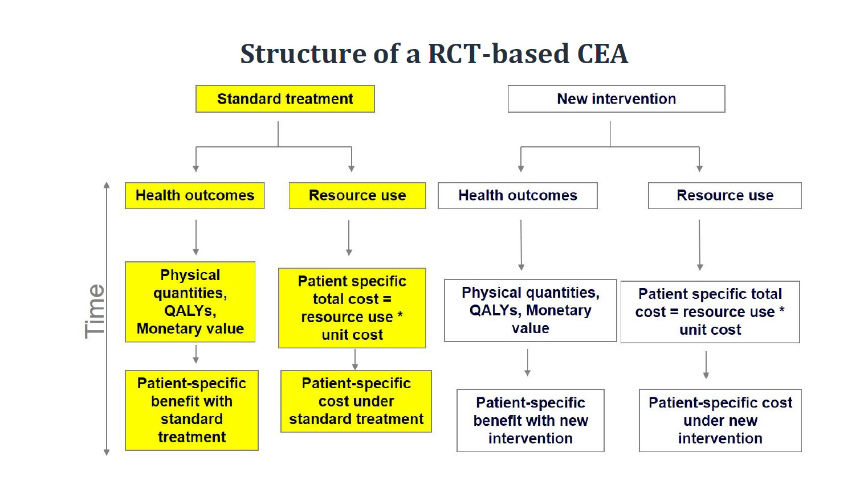

Slide 28
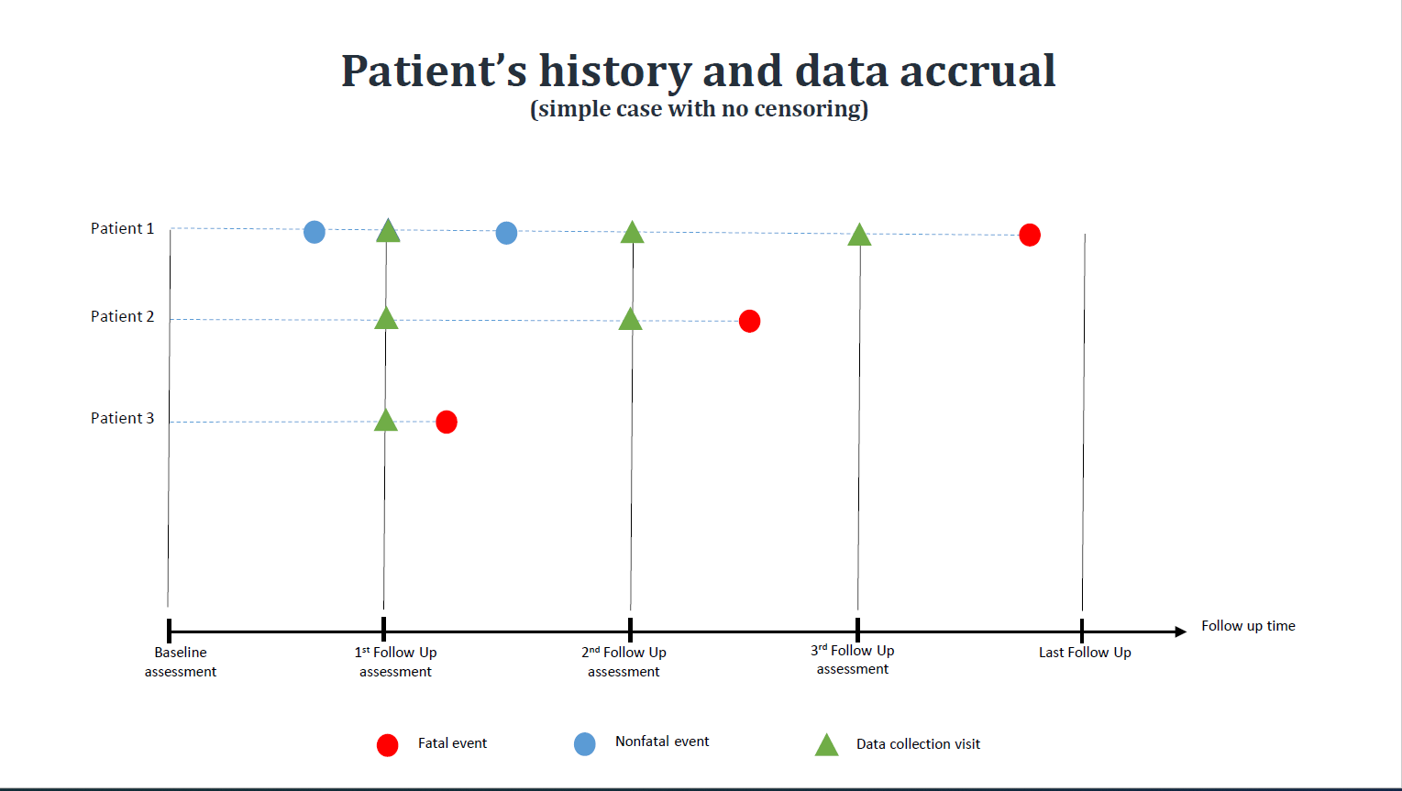

Slide 29
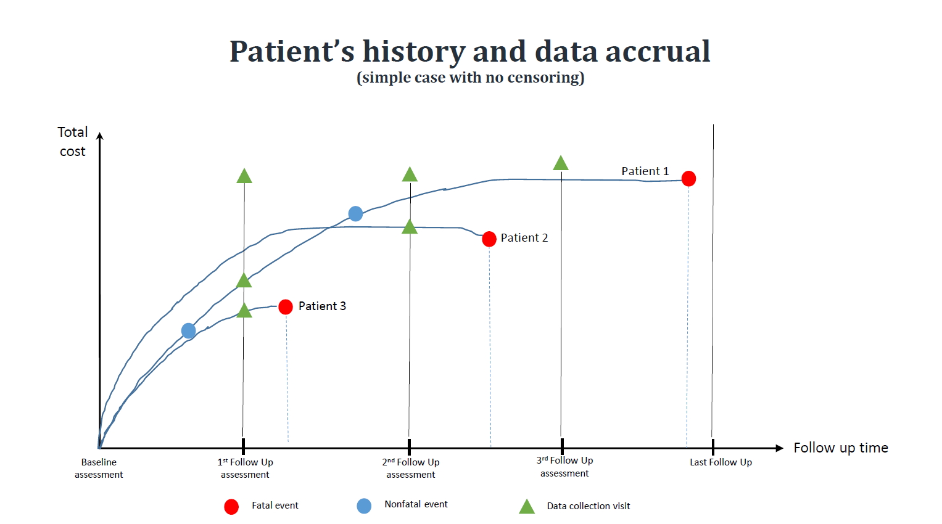

Slide 30
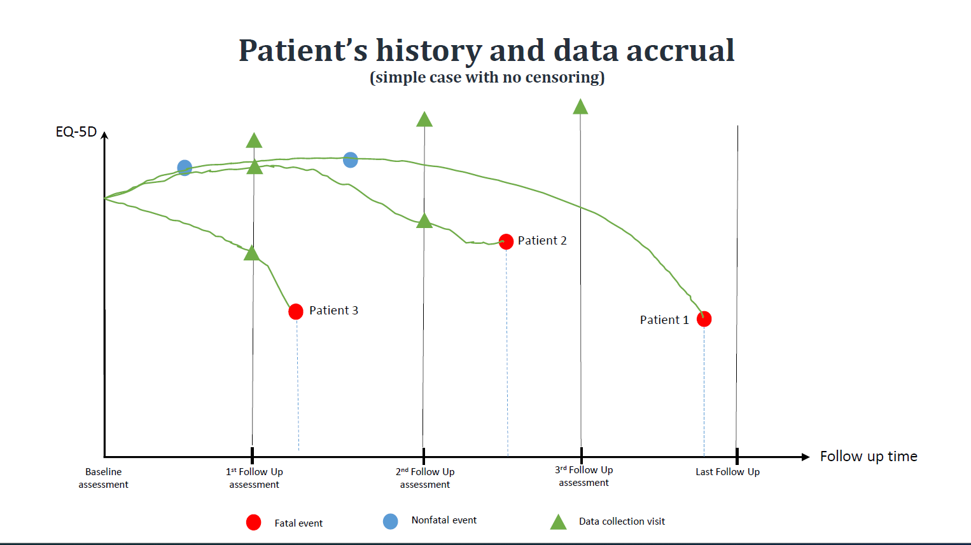

Slide 31
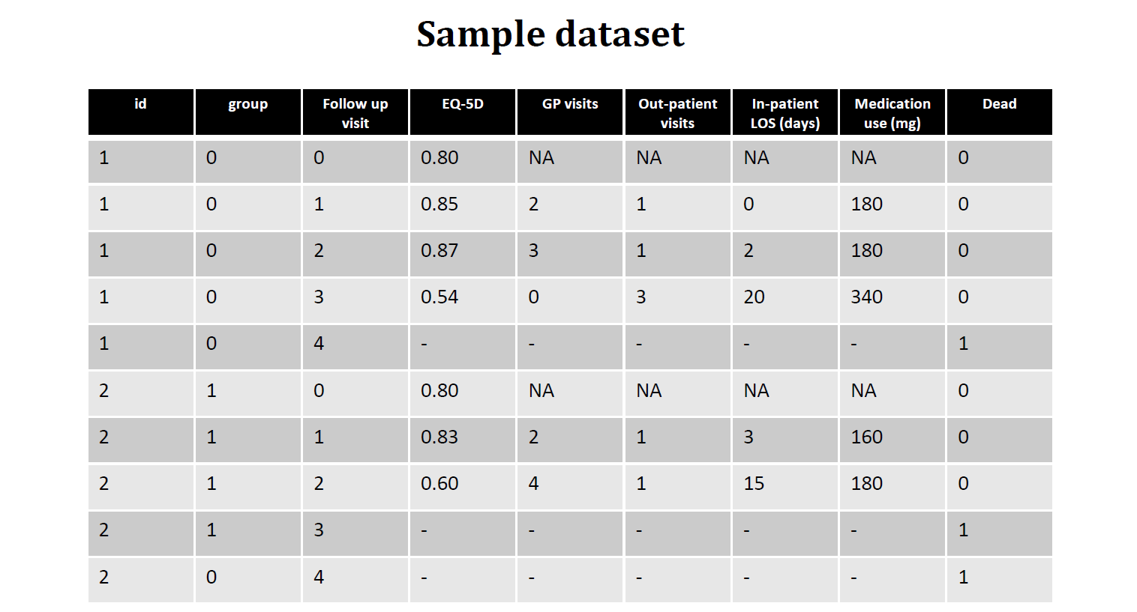

Slide 32
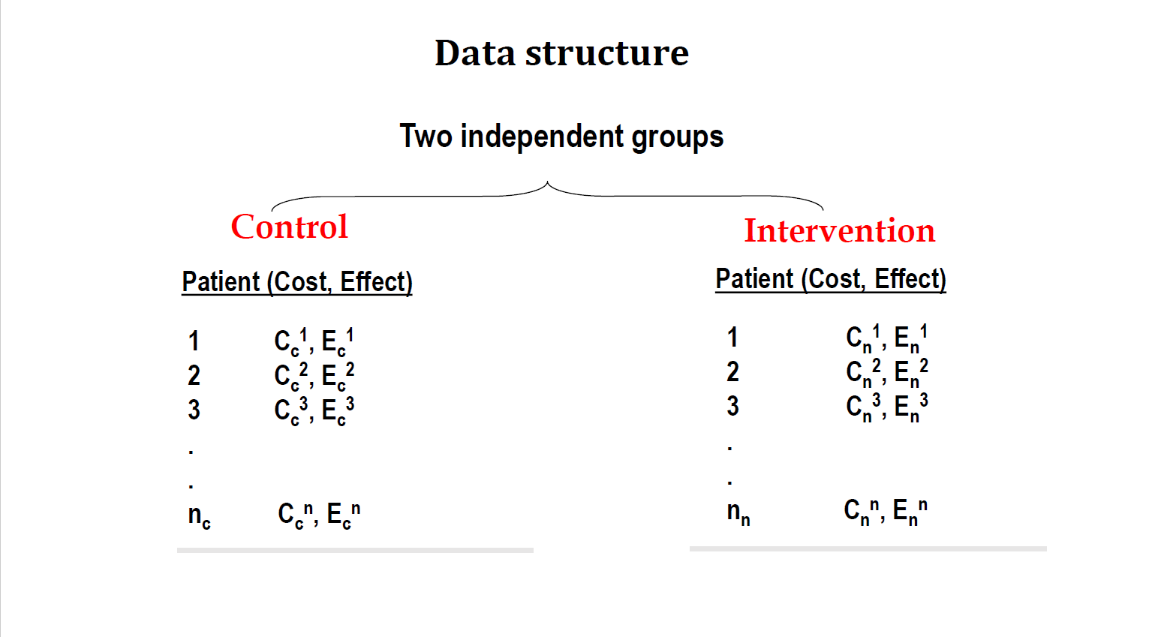

Slide 33
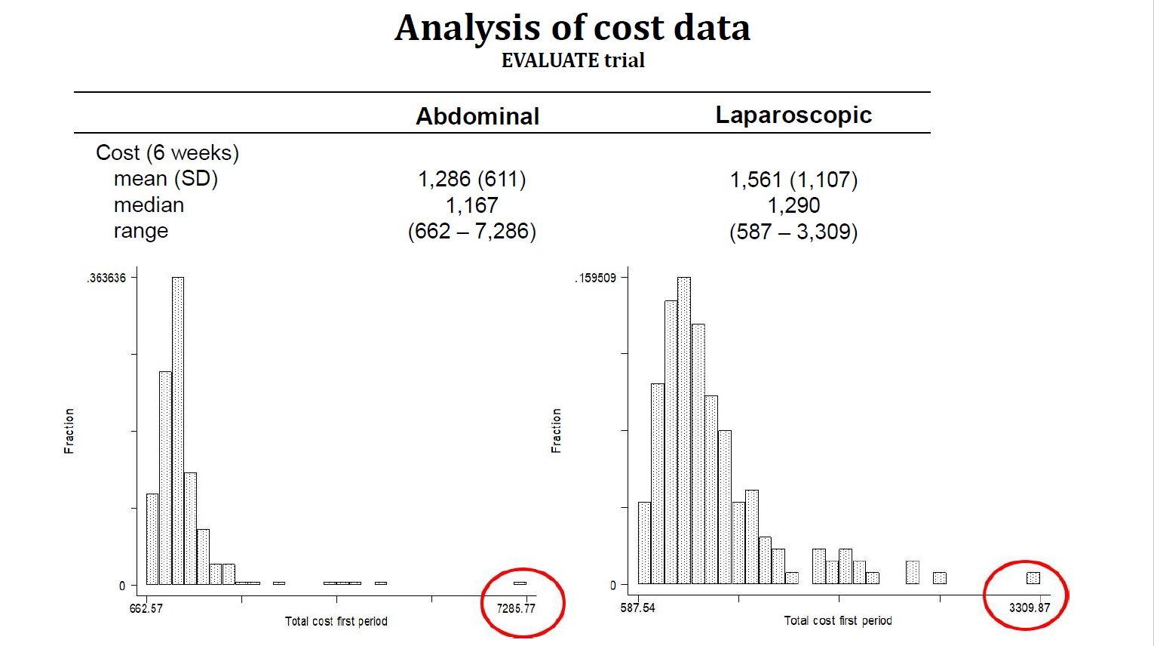

Slide 34
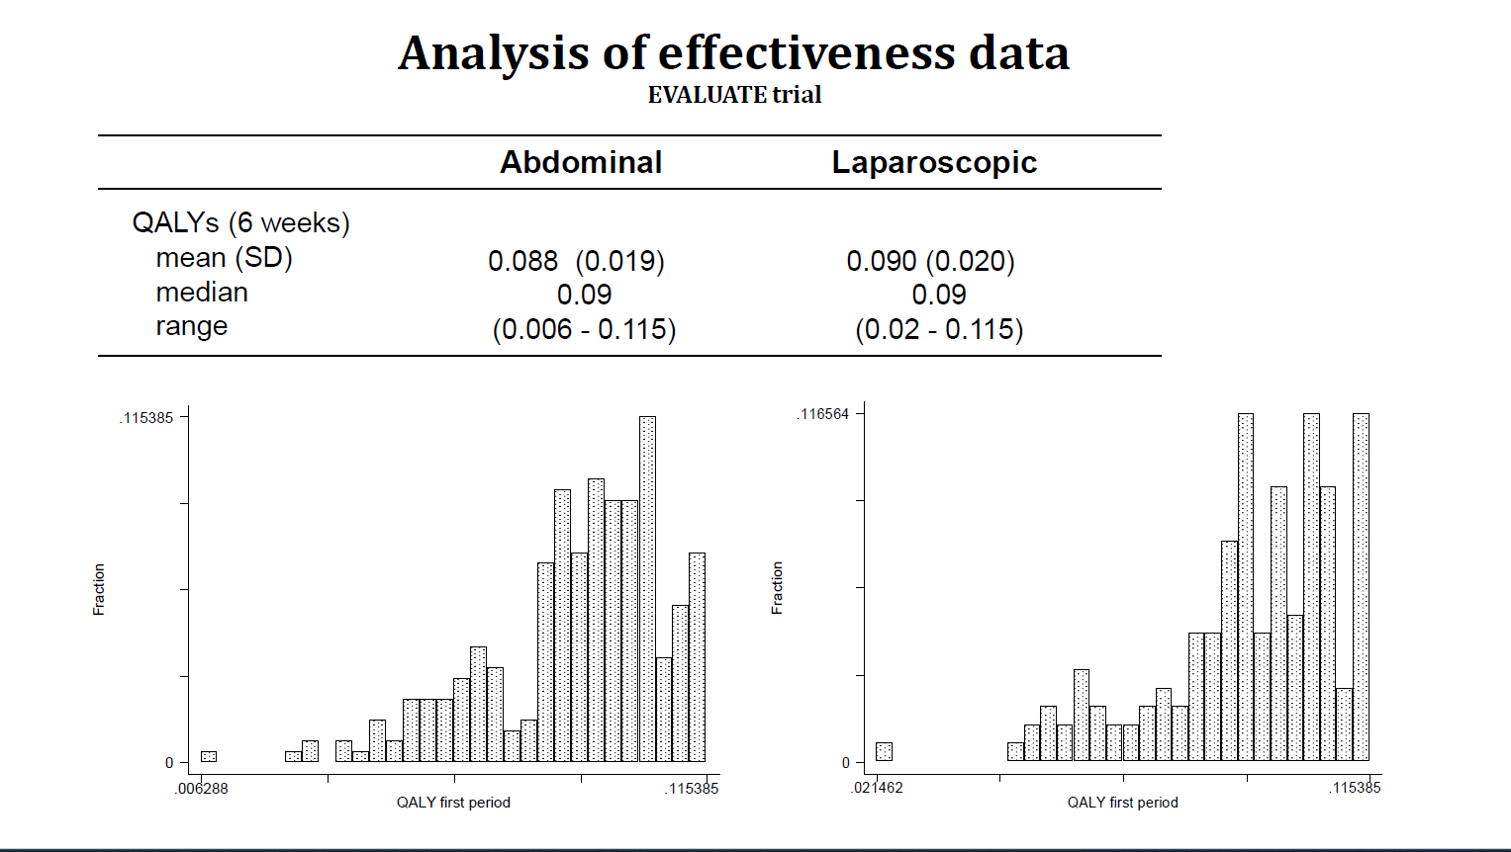

Slide 35
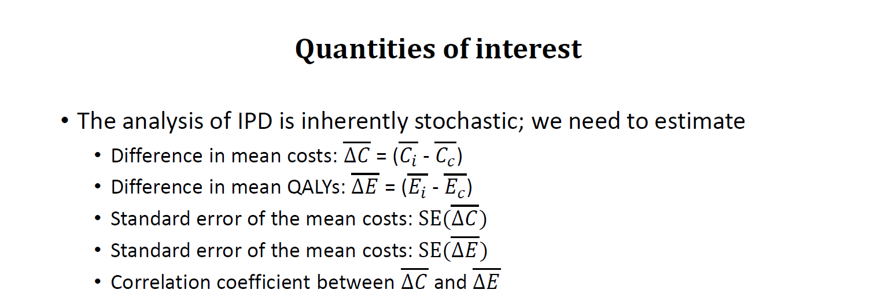

Slide 36
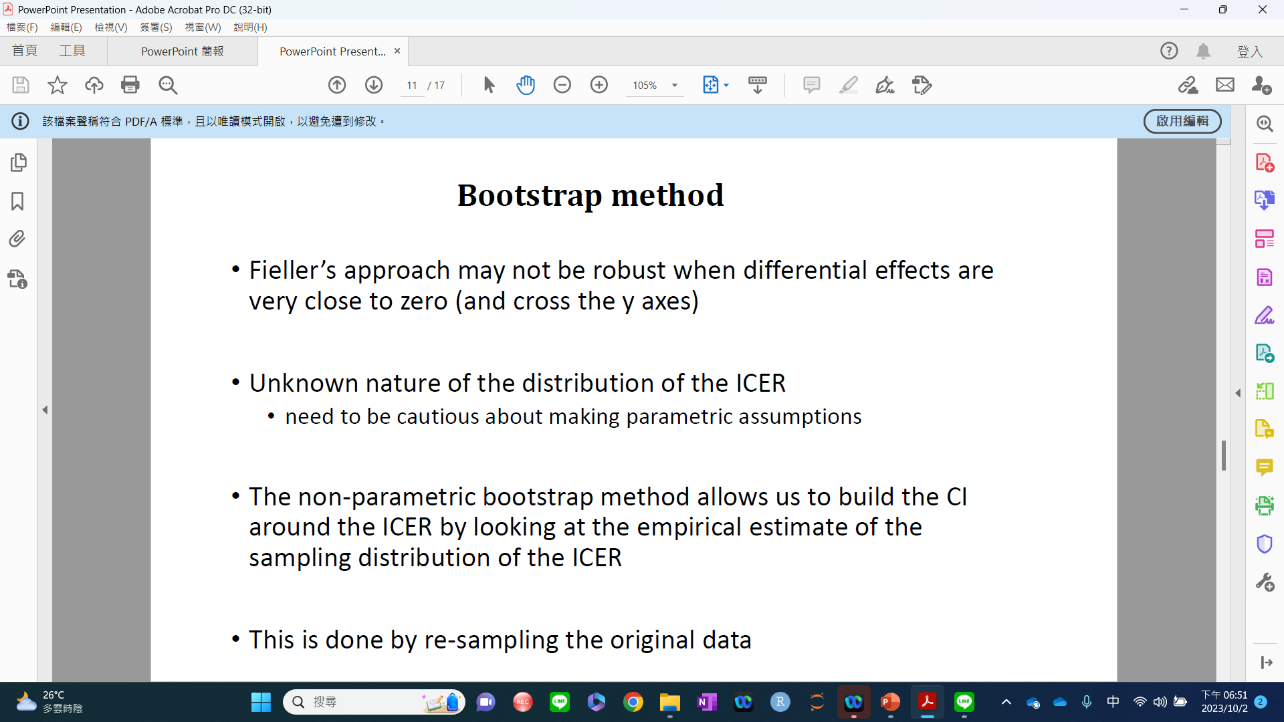
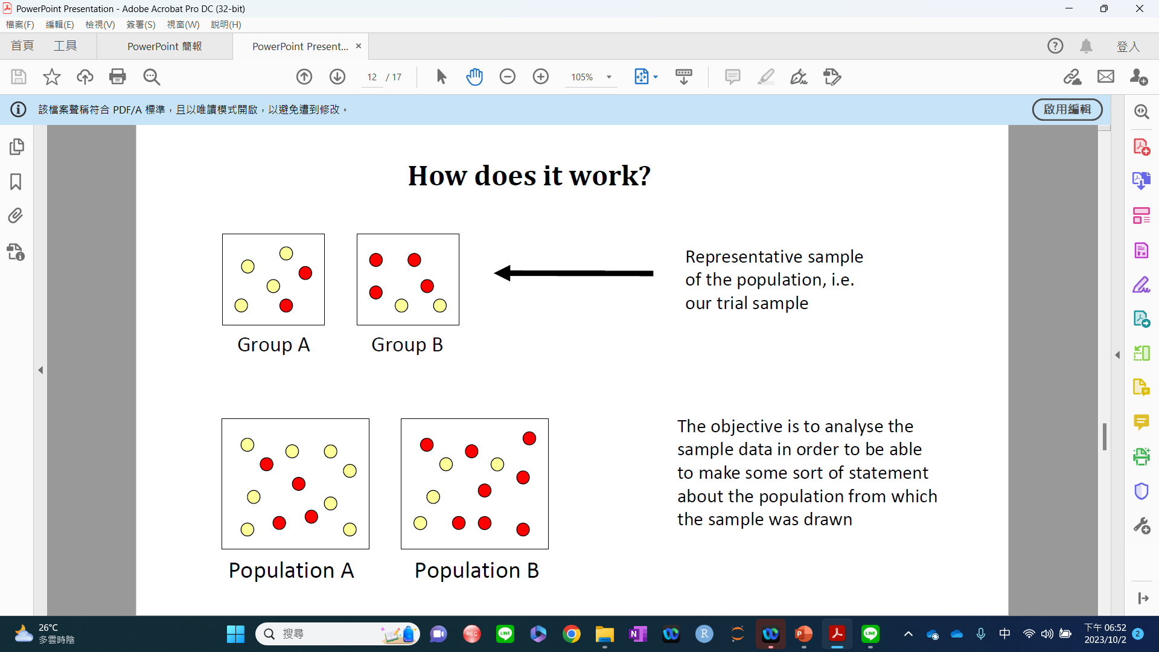

Slide 37
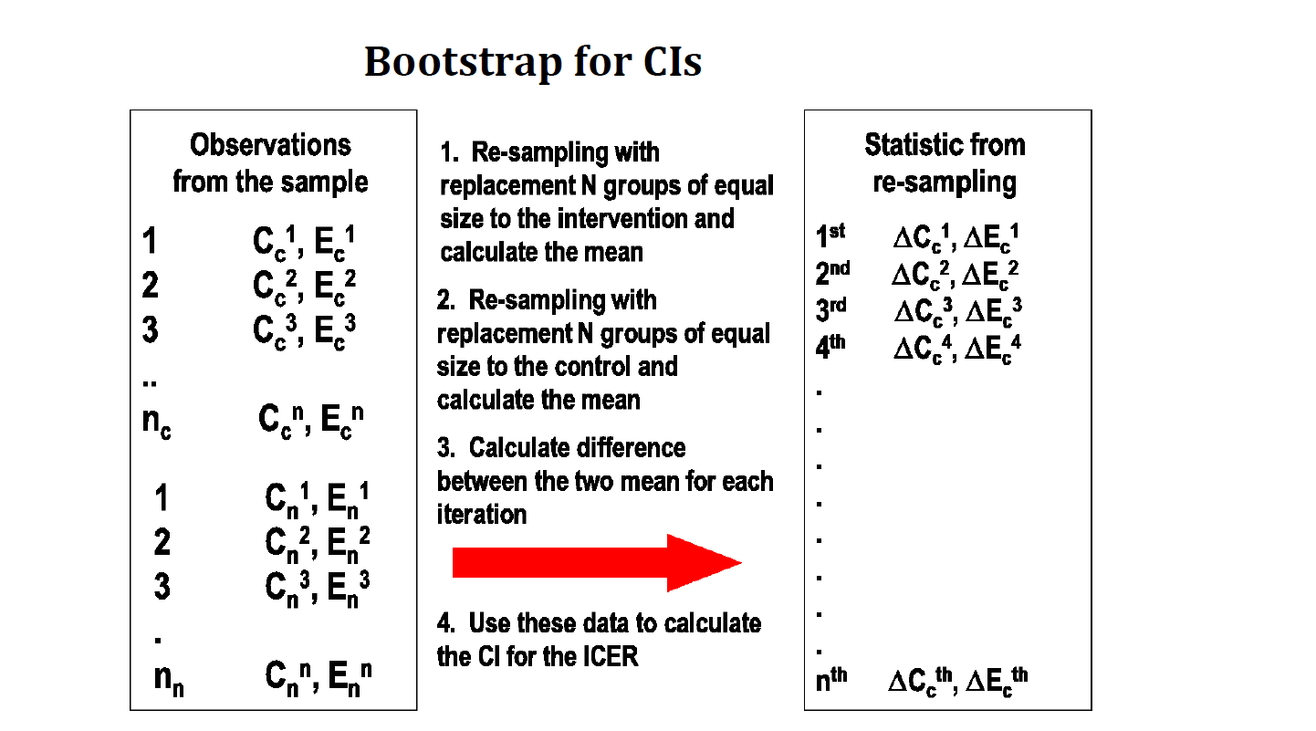

Slide 38
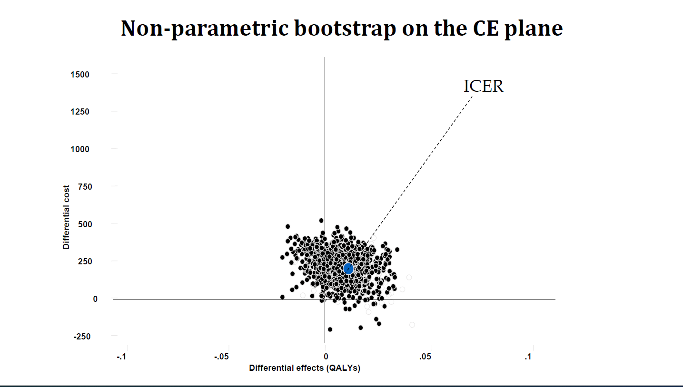

Slide 39
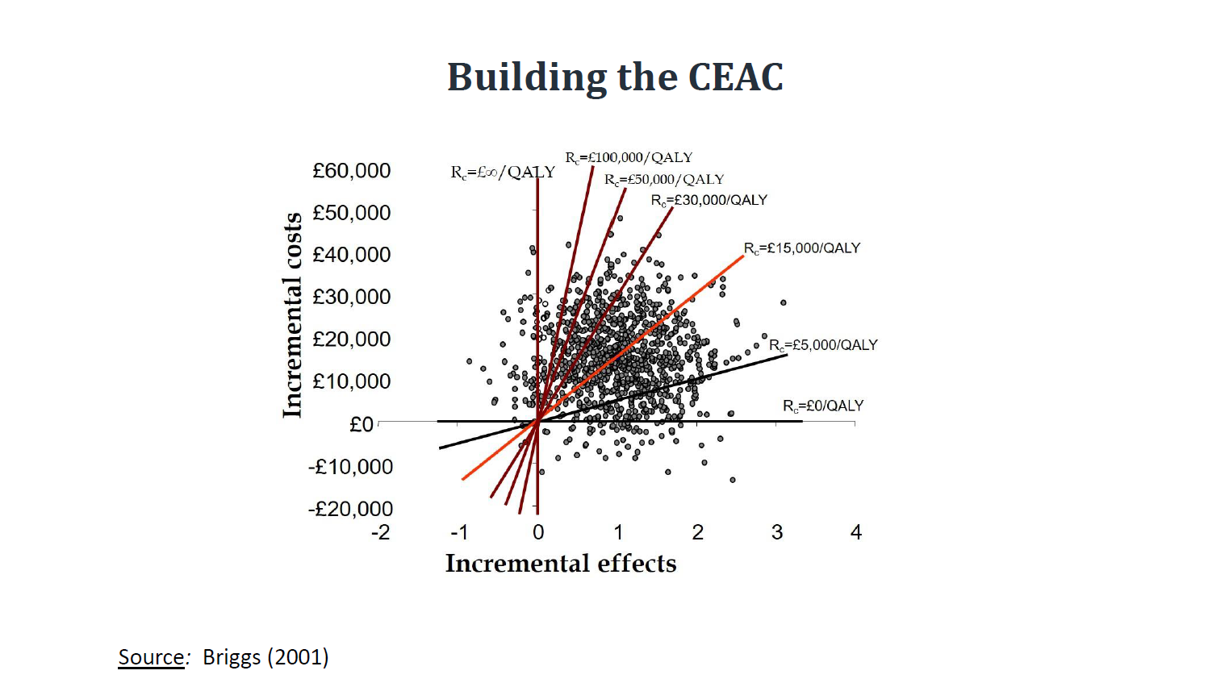

Slide 40
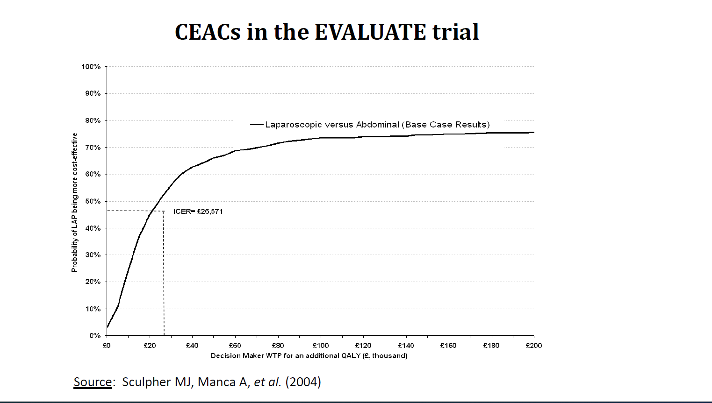

Slide 41
Decision Analytic Modeling (Briggs)
Cohort Models: a cohort model is any model which estimates the outcomes for the group of patients without explicitly considering the outcomes of each individual patient. A cohort model may allow for some variability in patient outcome according to patient characteristics defined at the start of the model
Decision tree
Markov model, Partitioned survival model
Patient-level simulation: a patient-level simulation as any model which estimates the mean costs and benefits for that group of patients by considering the costs and benefits of each individual within the group.

Slide 42
Decision Tree Model

Slide 43
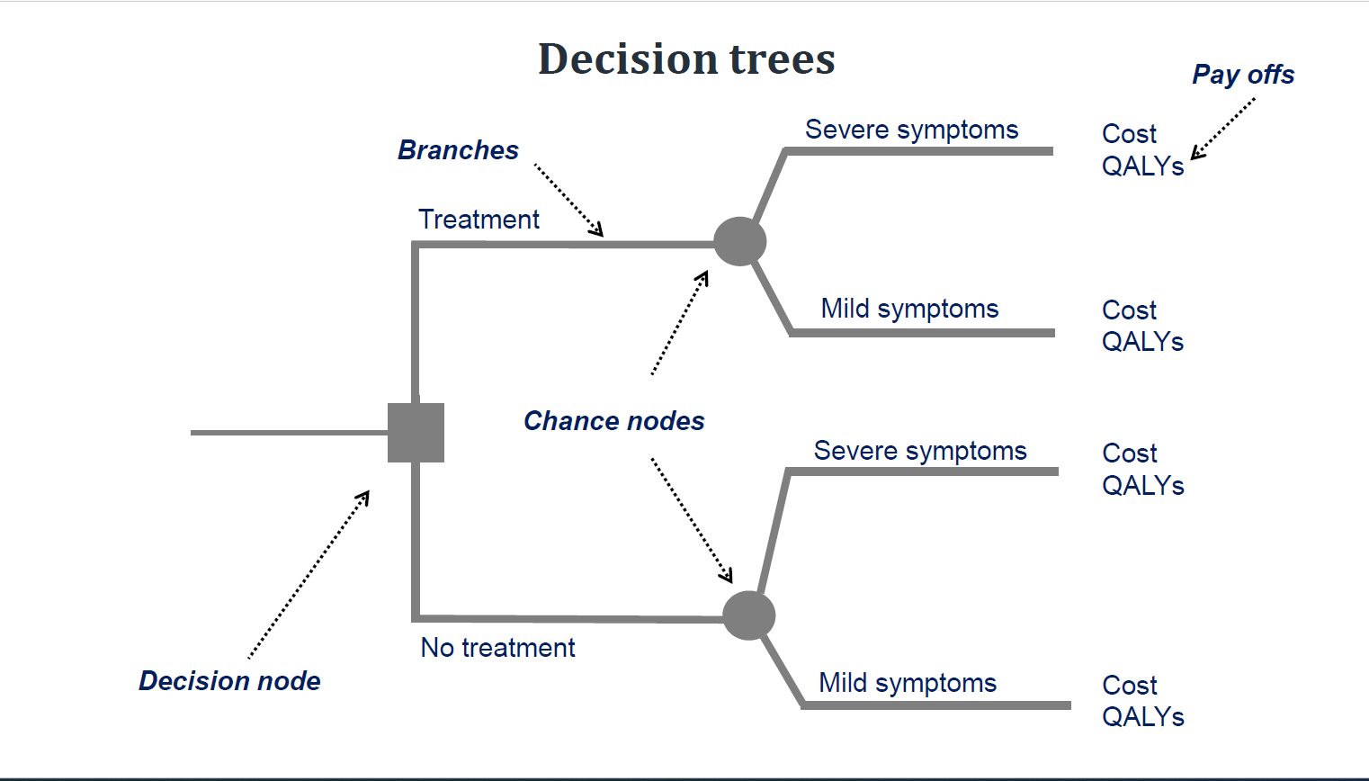

Slide 44
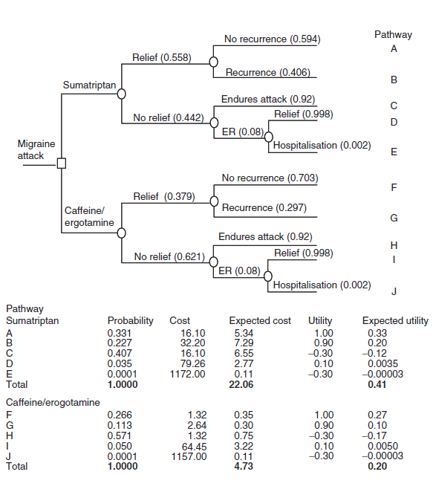
Decision Tree
Decision-analytical modeling (approaches):
Decision tree

Slide 45
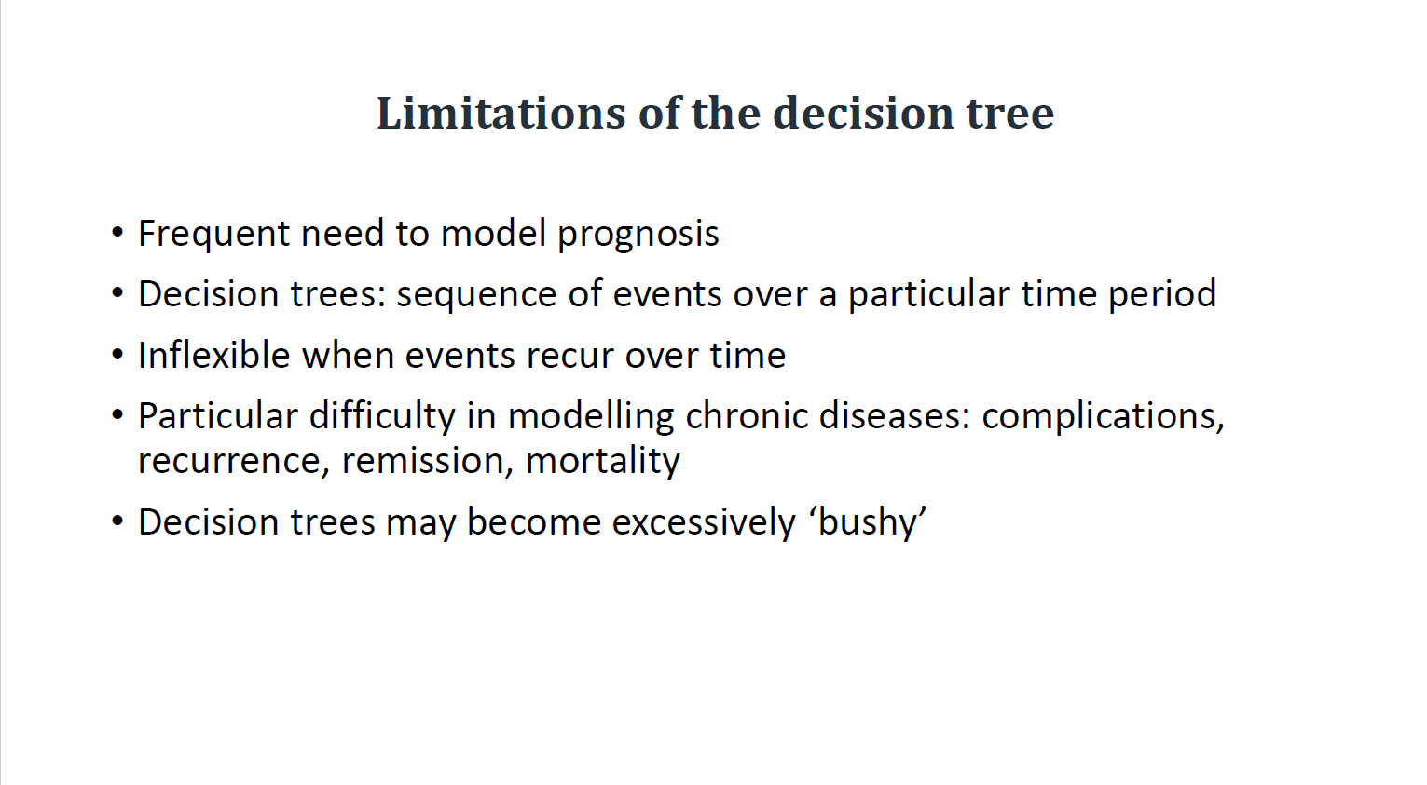

Slide 46

Markov Model
https://www.youtube.com/watch?v=d0xgyDs4EBc

Slide 47
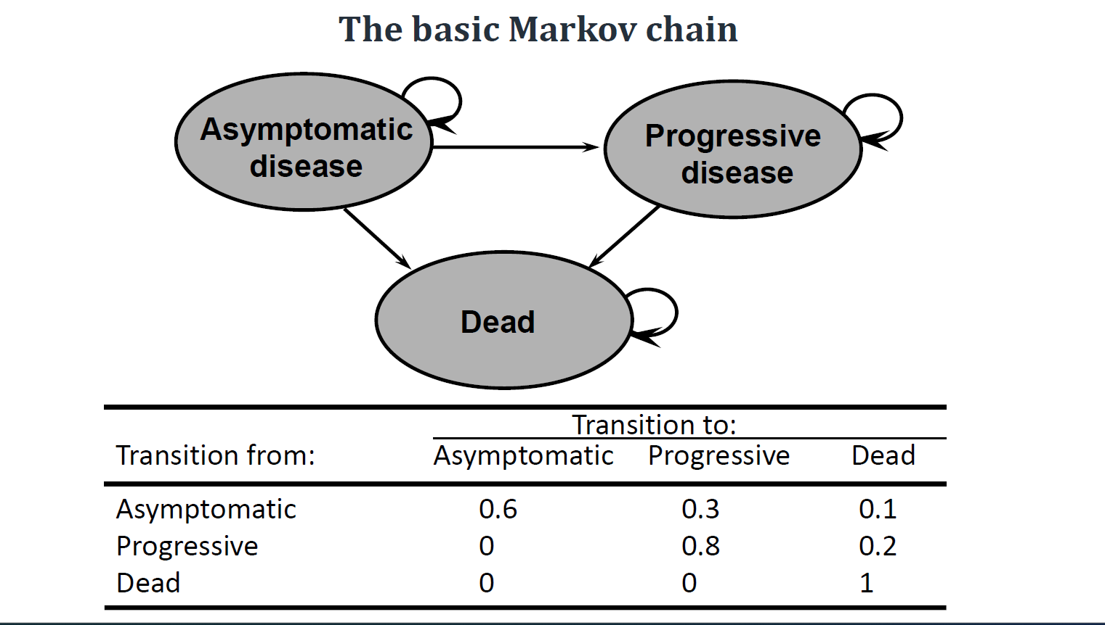

Slide 48
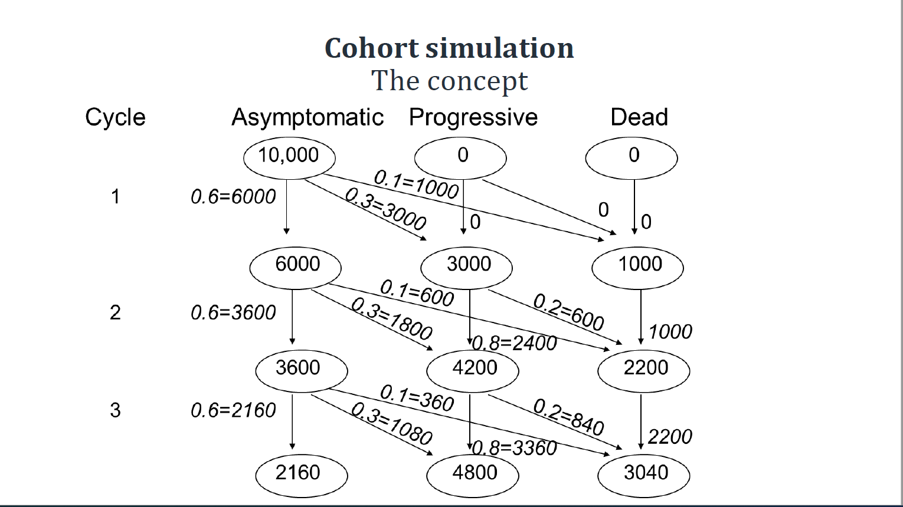

Slide 49
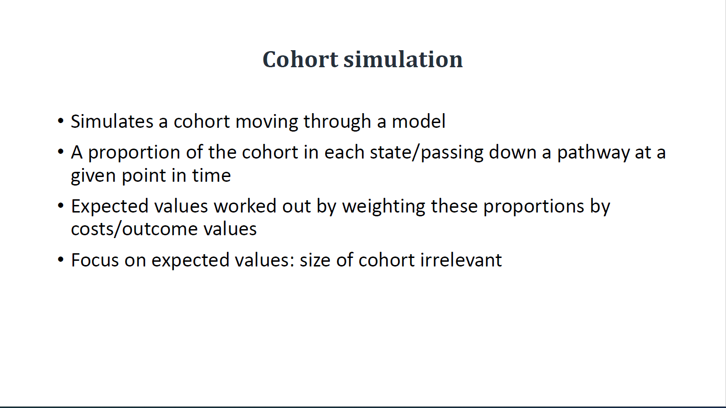

Slide 50
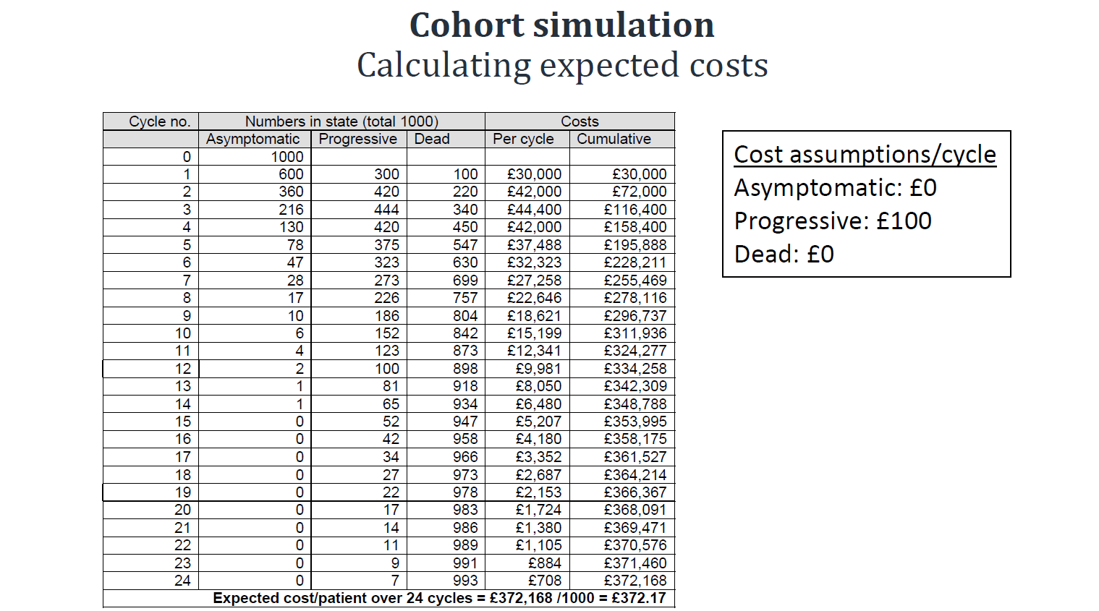

Slide 51
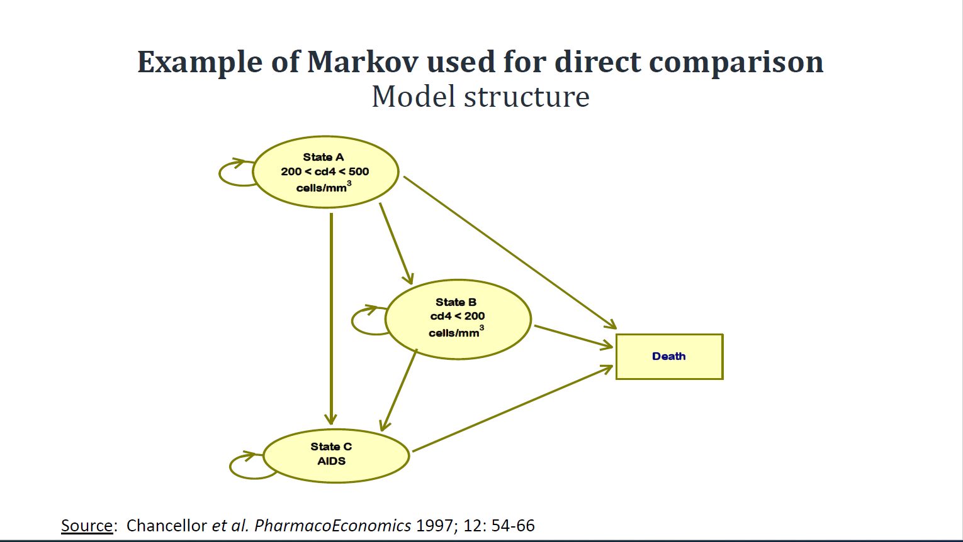

Slide 52
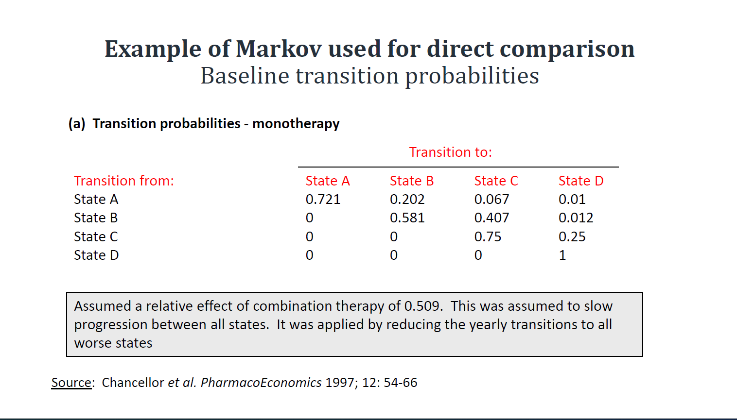

Slide 53
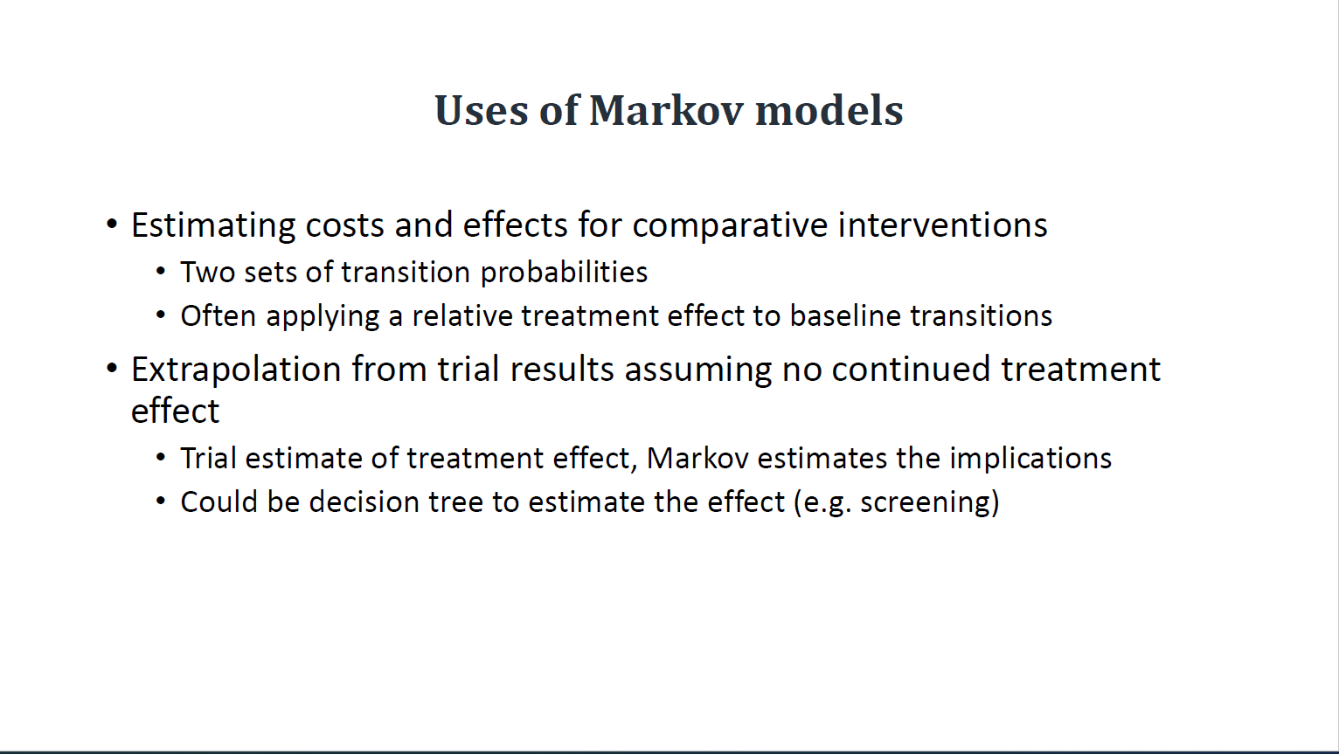

Slide 54
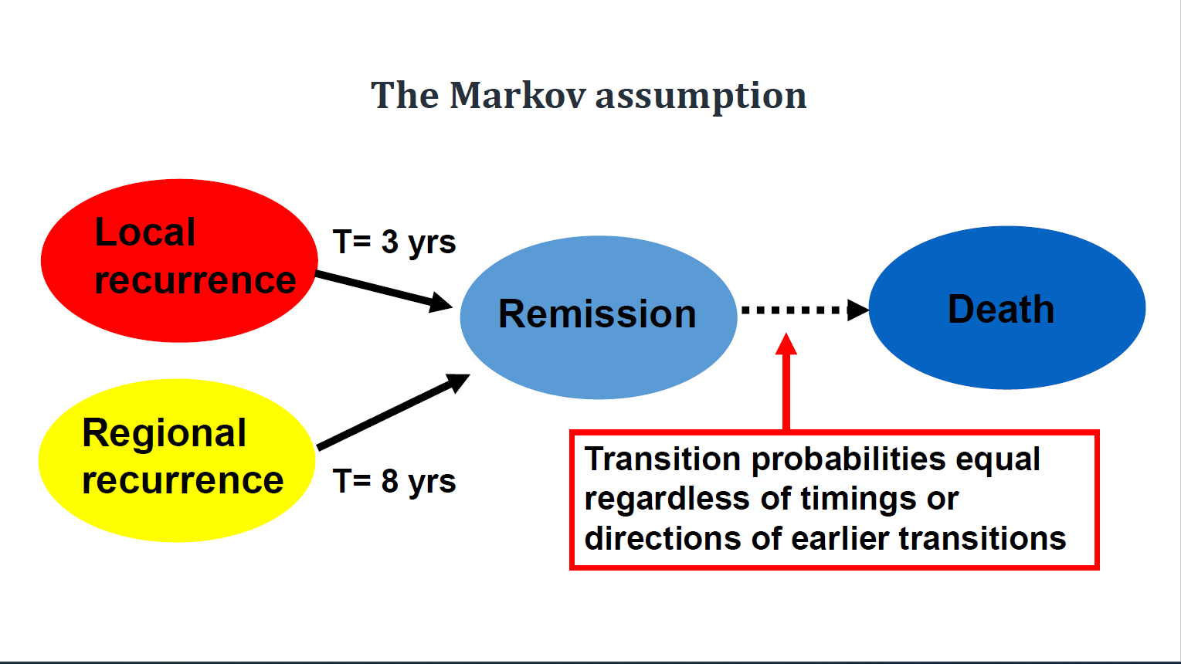

Slide 55
Part II: Survival Analysis

Slide 56
Questions
甚麼是存活分析?
如何分析(衡量)存活?
甚麼hazard function? 甚麼是survival function? 他們的關係是甚麼?
3. 常見的有哪些存活分析模式或函數?
KM
Cox Proportion Hazard models
Exponential, Weibull and Gompertz

Slide 57
Review of Markov model approach
Types of survival models: exponential, Weibull and Gompertz
A table with survival functions, hazard function and cumulative hazard function
Transition probability derived as
a. function of survival function or cumulative hazard function
b. function of survival function or cumulative hazard function, when provided with constant hazard ratio

Slide 58
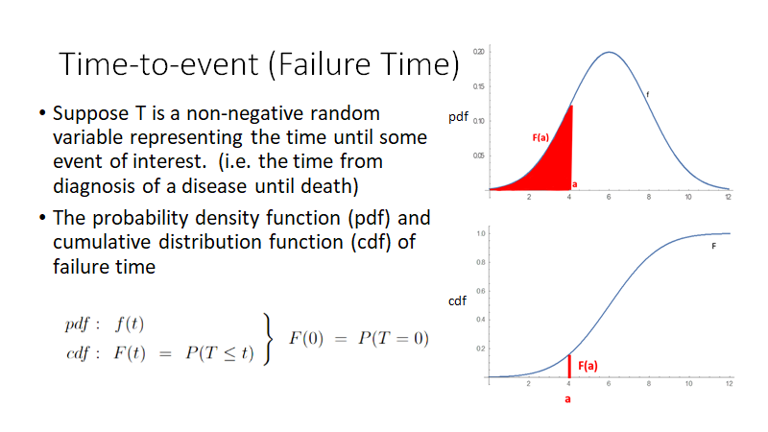

Slide 59
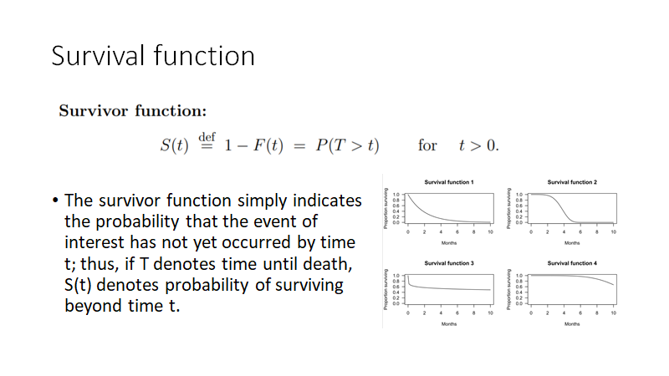

Slide 60
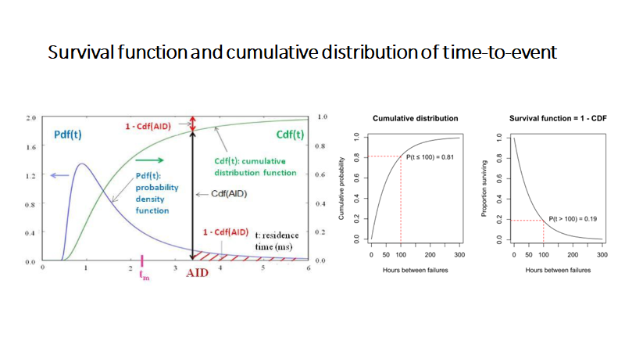

Slide 61
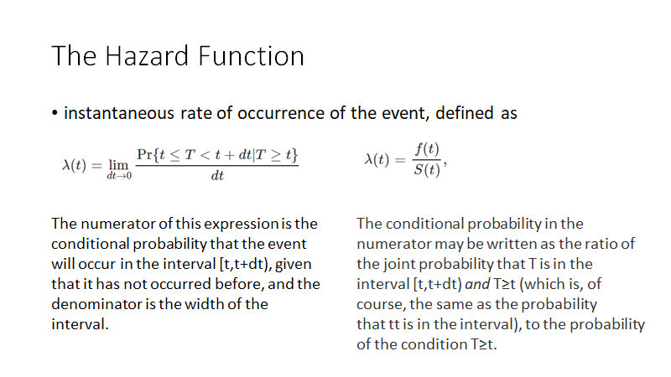

Slide 62
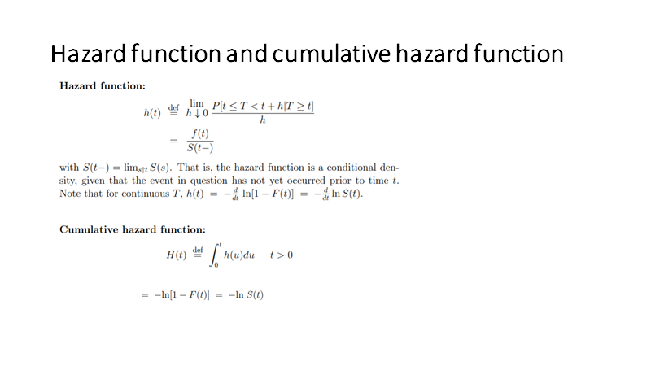

Slide 63
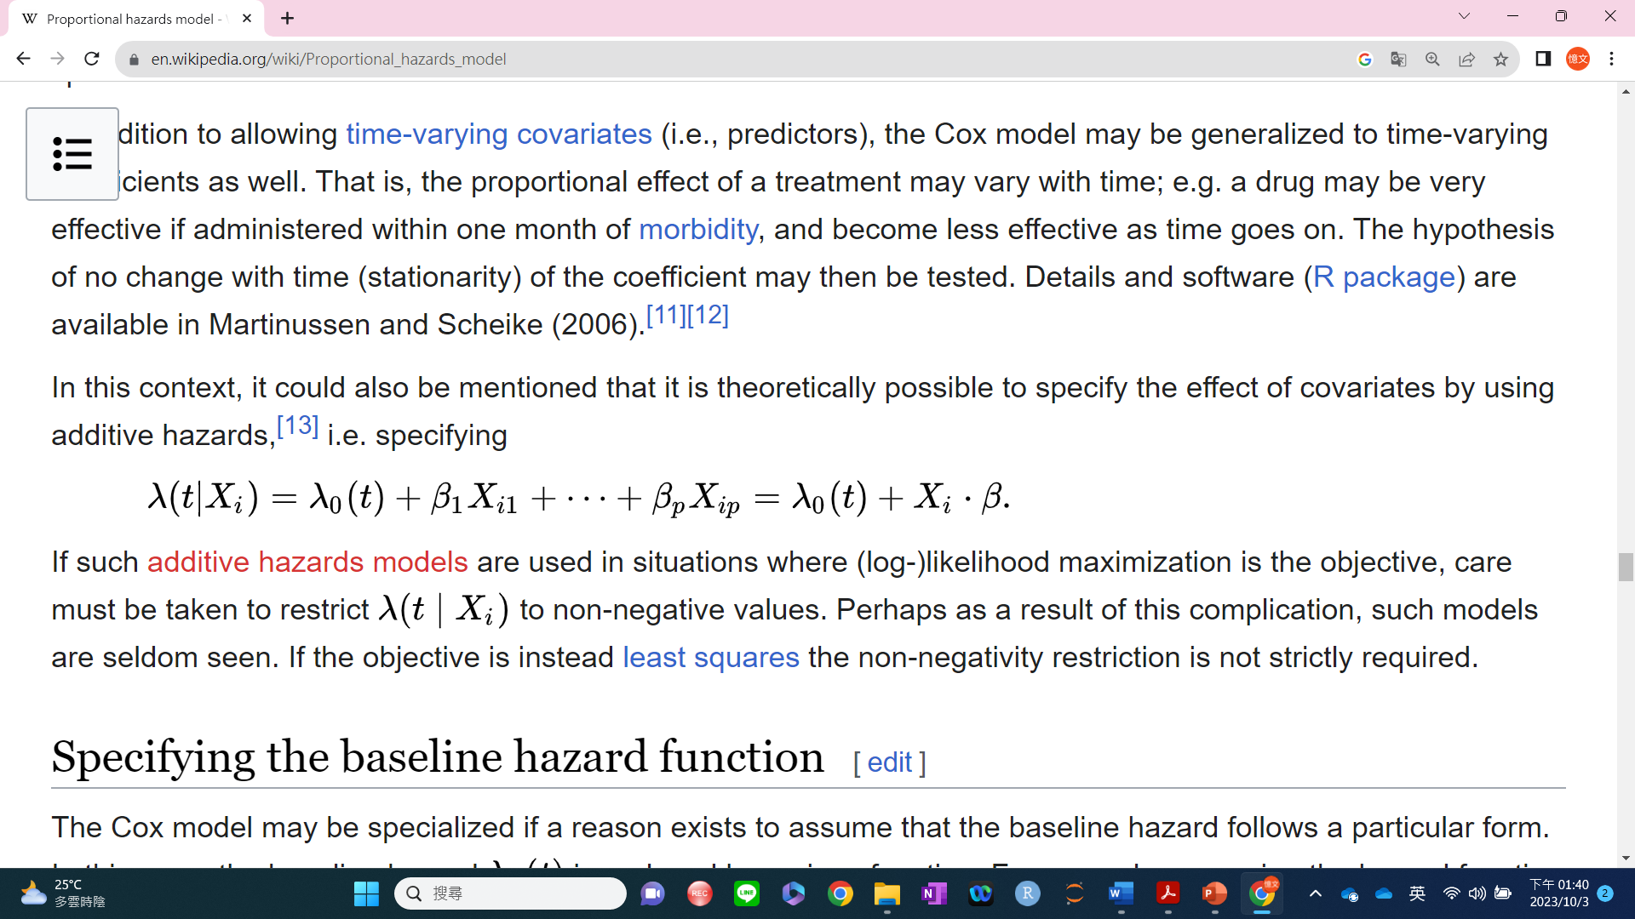
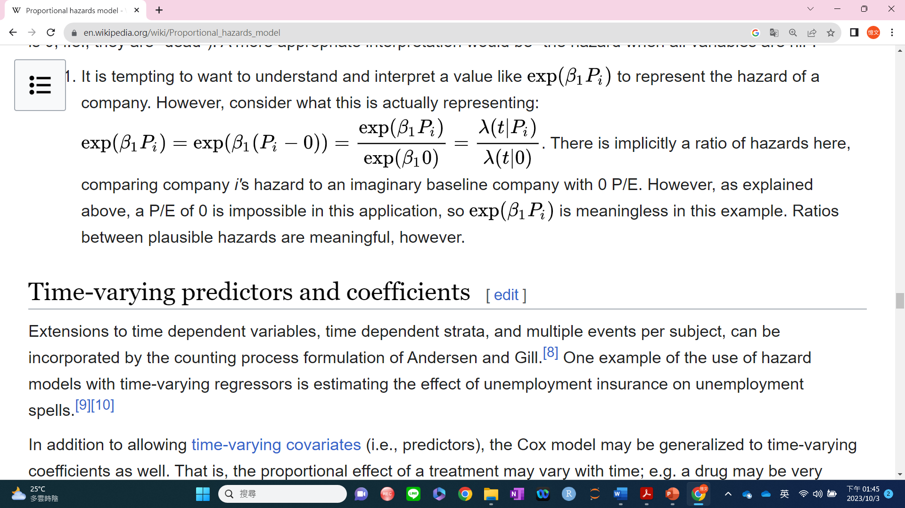
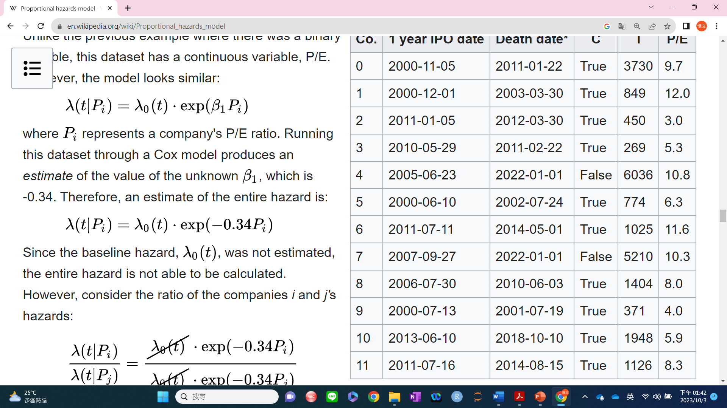
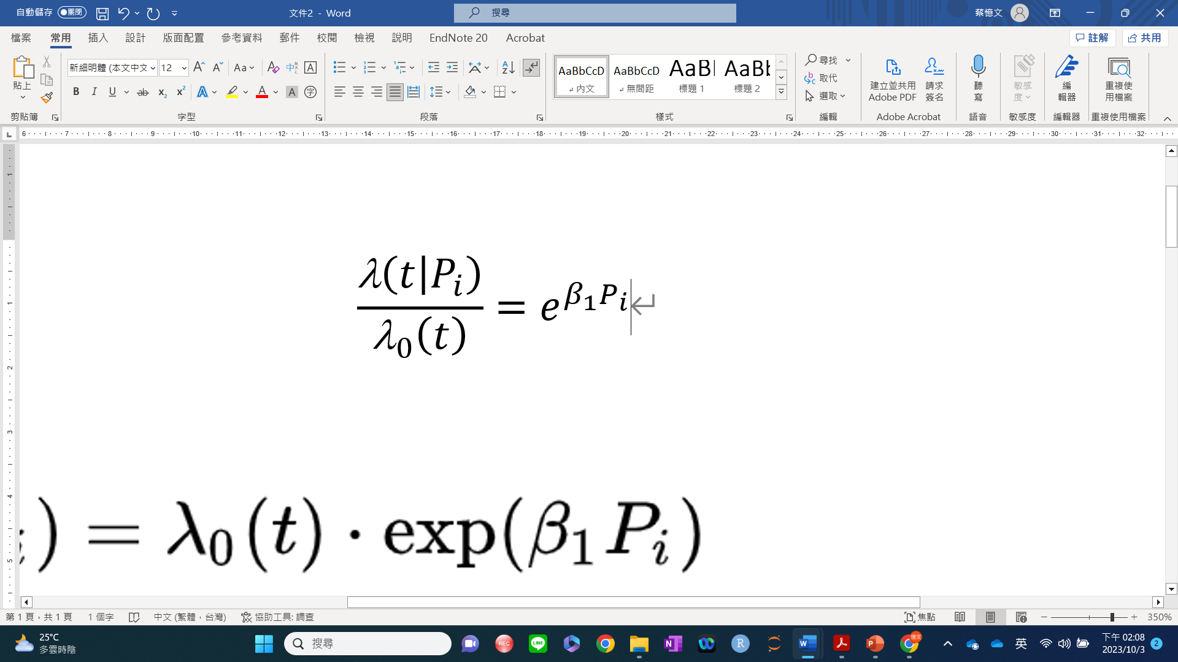

Proportional Hazard Ratio

Slide 64




Proportional Hazard

Slide 65


Slide 66


Slide 67



Slide 68


Slide 69



Slide 70


Slide 71



Slide 72


